Slide 1
Hash Table Collision Exercises
Similar to the first three questions on Homework 6

Slide 2
Quadratic Probing

Slide 3
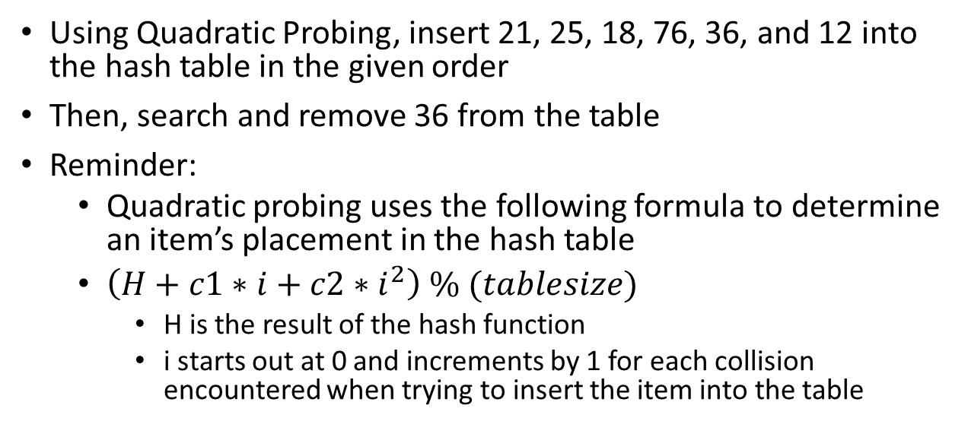
Assume that c1 = 1 and c2 =1 and that you are given the following hash table and the hash function is h(key) = key % 15
0
1
2
3 | 3
4
5 | 5
6
7
8
9
10
11
12
13
14 | 14
Using Quadratic Probing, insert 21, 25, 18, 76, 36, and 12 into the hash table in the given order
Then, search and remove 36 from the table
Reminder:
Quadratic probing uses the following formula to determine an item’s placement in the hash table
$\left(H+c1∗i+c2∗i^{2}\right) \% (tablesize)$
H is the result of the hash function
i starts out at 0 and increments by 1 for each collision encountered when trying to insert the item into the table

Slide 4
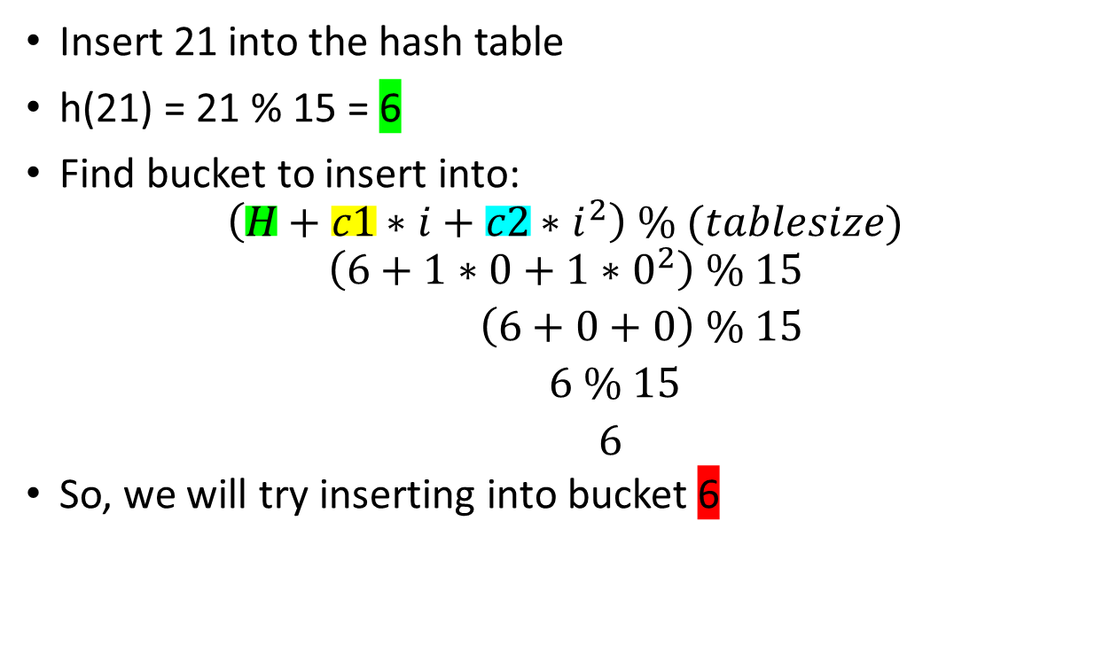
Assume that c1 = 1 and c2 =1 and that you are given the following hash table and the hash function is h(key) = key % 15
0
1
2
3 | 3
4
5 | 5
6
7
8
9
10
11
12
13
14 | 14
Insert 21 into the hash table
h(21) = 21 % 15 = 6
Find bucket to insert into:
$$\left(H+c1∗i+c2∗i^{2}\right) \% (tablesize)$$
$$\left(6+1∗0+1∗0^{2}\right) \% 15$$
$\left(6+0+0\right) \% 15$
$6 \% 15$
$6$
So, we will try inserting into bucket 6

Slide 5
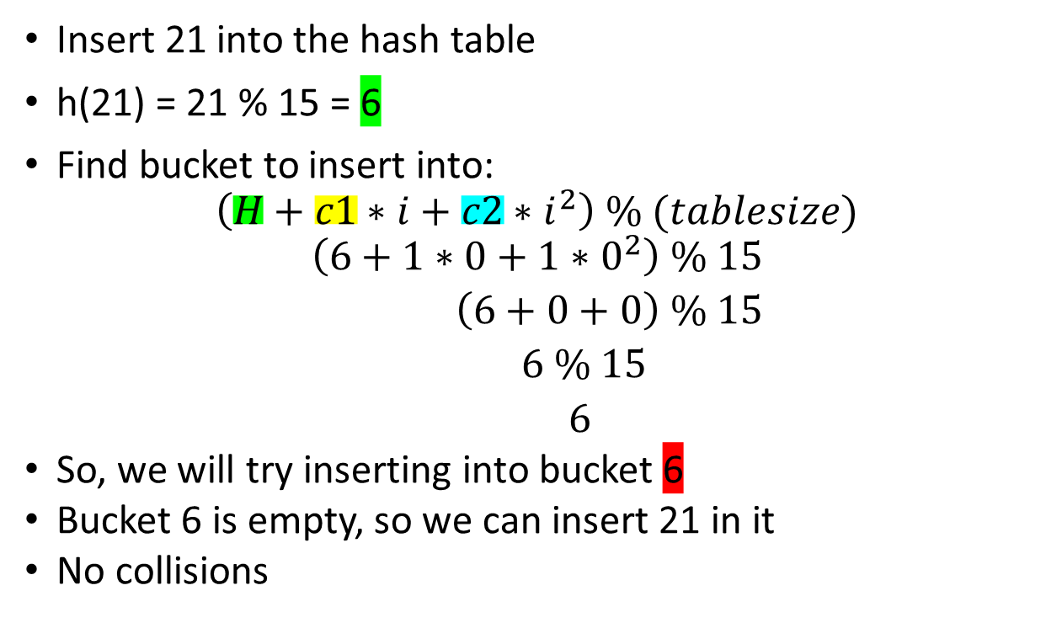
Assume that c1 = 1 and c2 =1 and that you are given the following hash table and the hash function is h(key) = key % 15
0
1
2
3 | 3
4
5 | 5
6 | 21
7
8
9
10
11
12
13
14 | 14
Insert 21 into the hash table
h(21) = 21 % 15 = 6
Find bucket to insert into:
$$\left(H+c1∗i+c2∗i^{2}\right) \% (tablesize)$$
$$\left(6+1∗0+1∗0^{2}\right) \% 15$$
$\left(6+0+0\right) \% 15$
$6 \% 15$
$6$
So, we will try inserting into bucket 6
Bucket 6 is empty, so we can insert 21 in it
No collisions

Slide 6
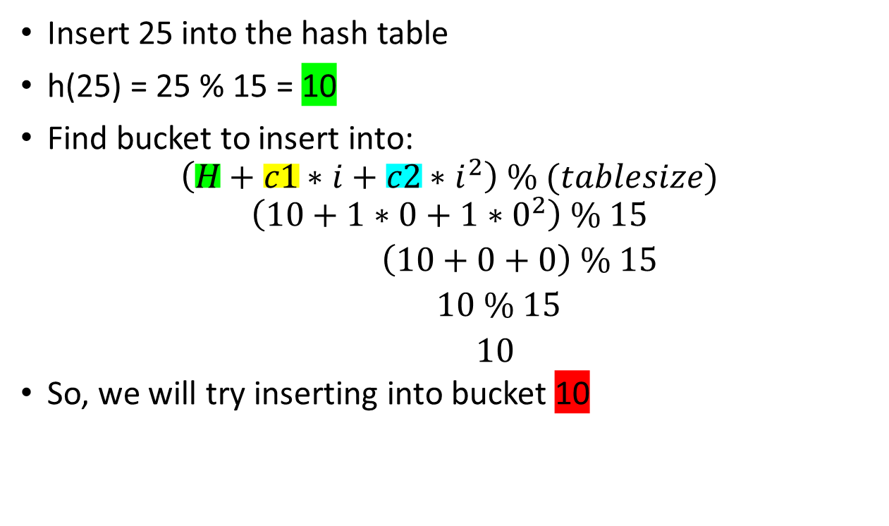
Assume that c1 = 1 and c2 =1 and that you are given the following hash table and the hash function is h(key) = key % 15
0
1
2
3 | 3
4
5 | 5
6 | 21
7
8
9
10
11
12
13
14 | 14
Insert 25 into the hash table
h(25) = 25 % 15 = 10
Find bucket to insert into:
$$\left(H+c1∗i+c2∗i^{2}\right) \% (tablesize)$$
$$\left(10+1∗0+1∗0^{2}\right) \% 15$$
$\left(10+0+0\right) \% 15$
$10 \% 15$
$10$
So, we will try inserting into bucket 10

Slide 7
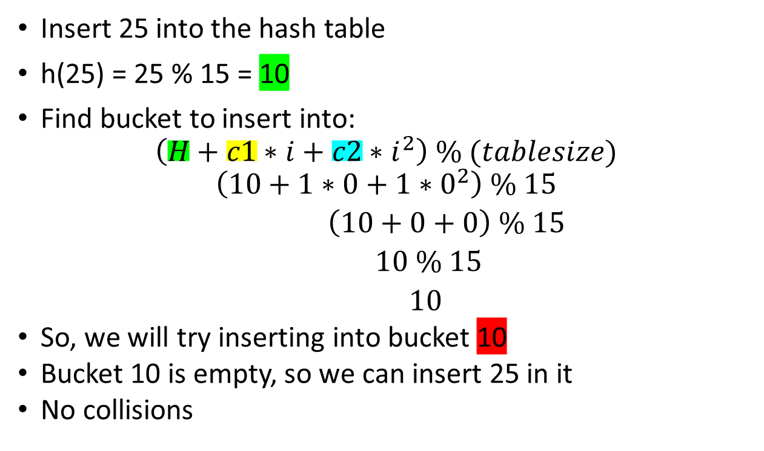
Assume that c1 = 1 and c2 =1 and that you are given the following hash table and the hash function is h(key) = key % 15
0
1
2
3 | 3
4
5 | 5
6 | 21
7
8
9
10 | 25
11
12
13
14 | 14
Insert 25 into the hash table
h(25) = 25 % 15 = 10
Find bucket to insert into:
$$\left(H+c1∗i+c2∗i^{2}\right) \% (tablesize)$$
$$\left(10+1∗0+1∗0^{2}\right) \% 15$$
$\left(10+0+0\right) \% 15$
$10 \% 15$
$10$
So, we will try inserting into bucket 10
Bucket 10 is empty, so we can insert 25 in it
No collisions

Slide 8

Assume that c1 = 1 and c2 =1 and that you are given the following hash table and the hash function is h(key) = key % 15
0
1
2
3 | 3
4
5 | 5
6 | 21
7
8
9
10 | 25
11
12
13
14 | 14
Insert 18 into the hash table
h(18) = 18 % 15 = 3
Find bucket to insert into:
$$\left(H+c1∗i+c2∗i^{2}\right) \% (tablesize)$$
$$\left(3+1∗0+1∗0^{2}\right) \% 15$$
$\left(3+0+0\right) \% 15$
$3 \% 15$
$3$
So, we will try inserting into bucket 3

Slide 9
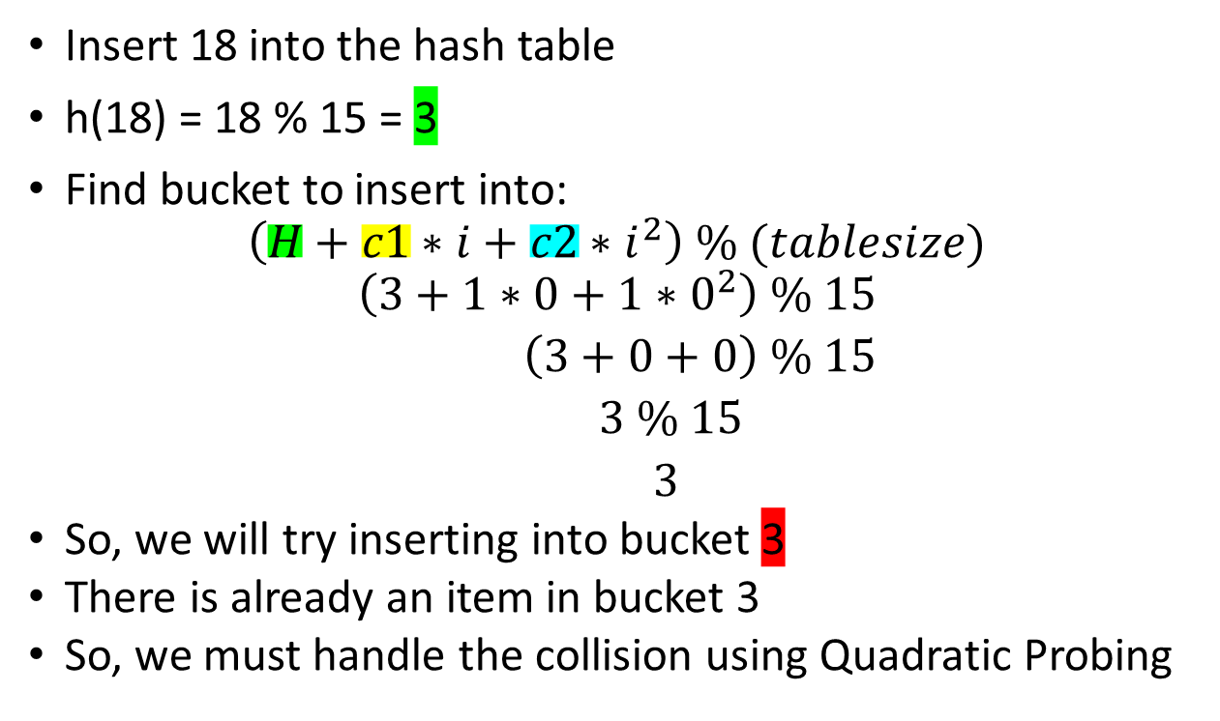
Assume that c1 = 1 and c2 =1 and that you are given the following hash table and the hash function is h(key) = key % 15
0
1
2
3 | 3
4
5 | 5
6 | 21
7
8
9
10 | 25
11
12
13
14 | 14
Insert 18 into the hash table
h(18) = 18 % 15 = 3
Find bucket to insert into:
$$\left(H+c1∗i+c2∗i^{2}\right) \% (tablesize)$$
$$\left(3+1∗0+1∗0^{2}\right) \% 15$$
$\left(3+0+0\right) \% 15$
$3 \% 15$
$3$
So, we will try inserting into bucket 3
There is already an item in bucket 3
So, we must handle the collision using Quadratic Probing

Slide 10
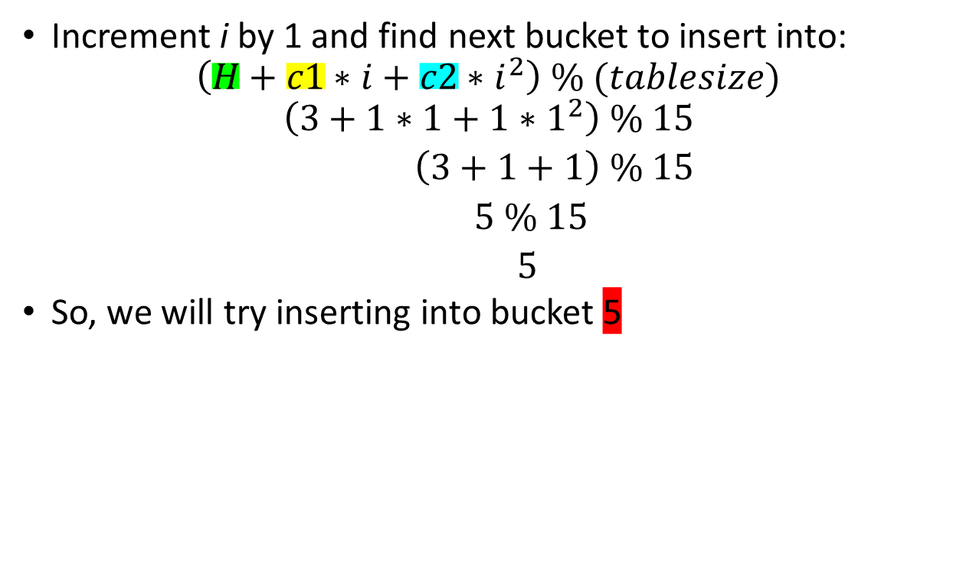
Assume that c1 = 1 and c2 =1 and that you are given the following hash table and the hash function is h(key) = key % 15
0
1
2
3 | 3
4
5 | 5
6 | 21
7
8
9
10 | 25
11
12
13
14 | 14
Increment i by 1 and find next bucket to insert into:
$$\left(H+c1∗i+c2∗i^{2}\right) \% (tablesize)$$
$$\left(3+1∗1+1∗1^{2}\right) \% 15$$
$\left(3+1+1\right) \% 15$
$5 \% 15$
$5$
So, we will try inserting into bucket 5

Slide 11
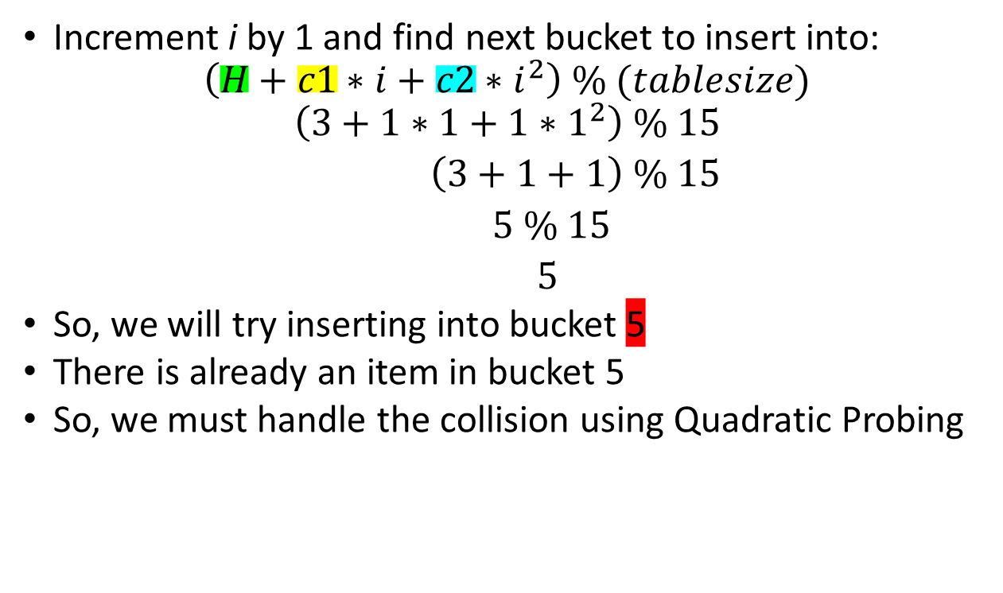
Assume that c1 = 1 and c2 =1 and that you are given the following hash table and the hash function is h(key) = key % 15
0
1
2
3 | 3
4
5 | 5
6 | 21
7
8
9
10 | 25
11
12
13
14 | 14
Increment i by 1 and find next bucket to insert into:
$$\left(H+c1∗i+c2∗i^{2}\right) \% (tablesize)$$
$$\left(3+1∗1+1∗1^{2}\right) \% 15$$
$\left(3+1+1\right) \% 15$
$5 \% 15$
$5$
So, we will try inserting into bucket 5
There is already an item in bucket 5
So, we must handle the collision using Quadratic Probing

Slide 12

Assume that c1 = 1 and c2 =1 and that you are given the following hash table and the hash function is h(key) = key % 15
0
1
2
3 | 3
4
5 | 5
6 | 21
7
8
9
10 | 25
11
12
13
14 | 14
Increment i by 1 and find next bucket to insert into:
$$\left(H+c1∗i+c2∗i^{2}\right) \% (tablesize)$$
$$\left(3+1∗2+1∗2^{2}\right) \% 15$$
$\left(3+2+4\right) \% 15$
$9 \% 15$
$9$
So, we will try inserting into bucket 9

Slide 13
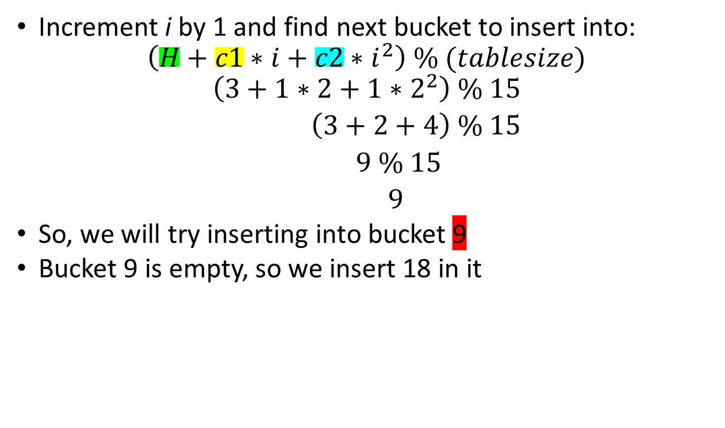
Assume that c1 = 1 and c2 =1 and that you are given the following hash table and the hash function is h(key) = key % 15
0
1
2
3 | 3
4
5 | 5
6 | 21
7
8
9 | 18
10 | 25
11
12
13
14 | 14
Increment i by 1 and find next bucket to insert into:
$$\left(H+c1∗i+c2∗i^{2}\right) \% (tablesize)$$
$$\left(3+1∗2+1∗2^{2}\right) \% 15$$
$\left(3+2+4\right) \% 15$
$9 \% 15$
$9$
So, we will try inserting into bucket 9
Bucket 9 is empty, so we insert 18 in it

Slide 14
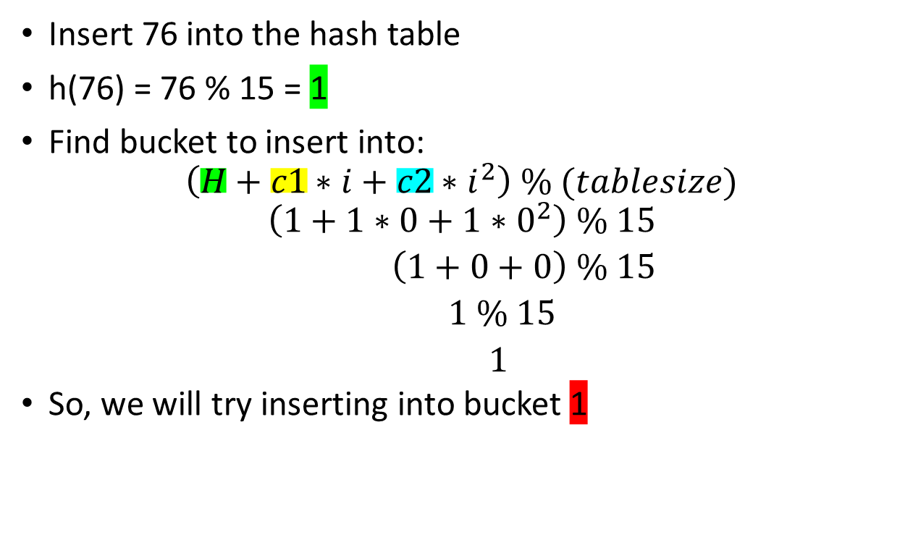
Assume that c1 = 1 and c2 =1 and that you are given the following hash table and the hash function is h(key) = key % 15
0
1
2
3 | 3
4
5 | 5
6 | 21
7
8
9 | 18
10 | 25
11
12
13
14 | 14
Insert 76 into the hash table
h(76) = 76 % 15 = 1
Find bucket to insert into:
$$\left(H+c1∗i+c2∗i^{2}\right) \% (tablesize)$$
$$\left(1+1∗0+1∗0^{2}\right) \% 15$$
$\left(1+0+0\right) \% 15$
$1 \% 15$
$1$
So, we will try inserting into bucket 1

Slide 15
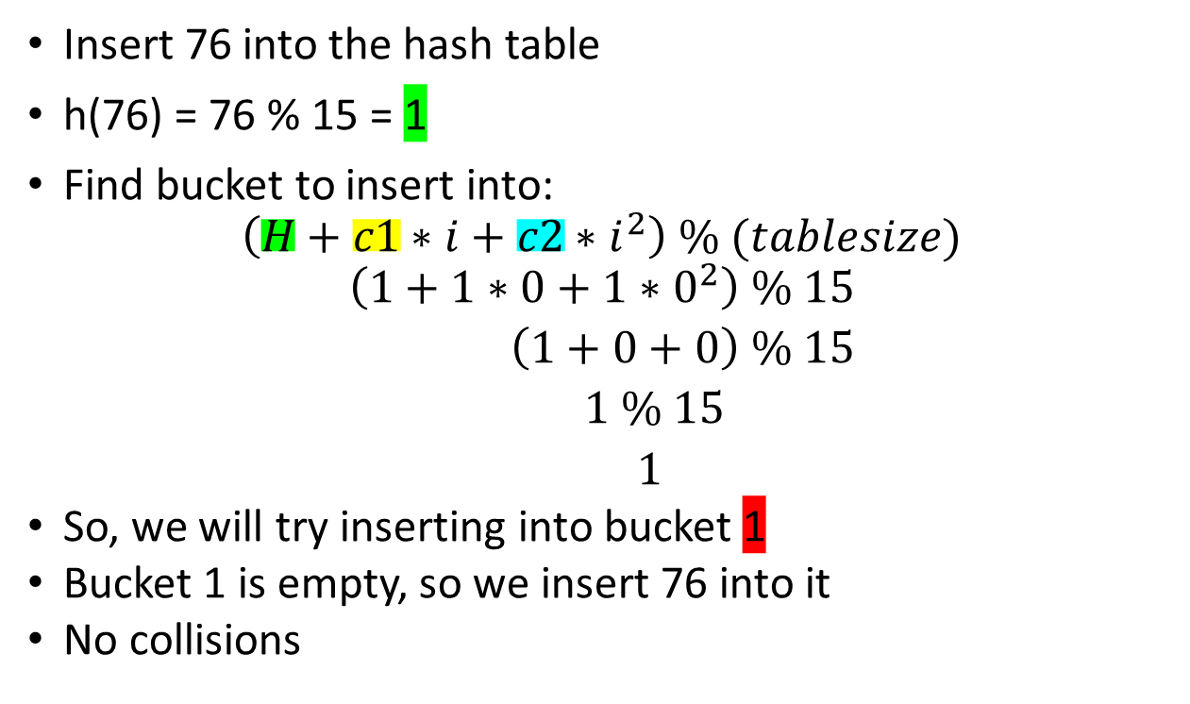
Assume that c1 = 1 and c2 =1 and that you are given the following hash table and the hash function is h(key) = key % 15
0
1 | 76
2
3 | 3
4
5 | 5
6 | 21
7
8
9 | 18
10 | 25
11
12
13
14 | 14
Insert 76 into the hash table
h(76) = 76 % 15 = 1
Find bucket to insert into:
$$\left(H+c1∗i+c2∗i^{2}\right) \% (tablesize)$$
$$\left(1+1∗0+1∗0^{2}\right) \% 15$$
$\left(1+0+0\right) \% 15$
$1 \% 15$
$1$
So, we will try inserting into bucket 1
Bucket 1 is empty, so we insert 76 into it
No collisions

Slide 16

Assume that c1 = 1 and c2 =1 and that you are given the following hash table and the hash function is h(key) = key % 15
0
1 | 76
2
3 | 3
4
5 | 5
6 | 21
7
8
9 | 18
10 | 25
11
12
13
14 | 14
Insert 36 into the hash table
h(36) = 36 % 15 = 6
Find bucket to insert into:
$$\left(H+c1∗i+c2∗i^{2}\right) \% (tablesize)$$
$$\left(6+1∗0+1∗0^{2}\right) \% 15$$
$\left(6+0+0\right) \% 15$
$6 \% 15$
$6$
So, we will try inserting into bucket 6

Slide 17

Assume that c1 = 1 and c2 =1 and that you are given the following hash table and the hash function is h(key) = key % 15
0
1 | 76
2
3 | 3
4
5 | 5
6 | 21
7
8
9 | 18
10 | 25
11
12
13
14 | 14
Insert 36 into the hash table
h(36) = 36 % 15 = 6
Find bucket to insert into:
$$\left(H+c1∗i+c2∗i^{2}\right) \% (tablesize)$$
$$\left(6+1∗0+1∗0^{2}\right) \% 15$$
$\left(6+0+0\right) \% 15$
$6 \% 15$
$6$
So, we will try inserting into bucket 6
There is already an item in bucket 5
So, we must handle the collision using Quadratic Probing

Slide 18

Assume that c1 = 1 and c2 =1 and that you are given the following hash table and the hash function is h(key) = key % 15
0
1 | 76
2
3 | 3
4
5 | 5
6 | 21
7
8
9 | 18
10 | 25
11
12
13
14 | 14
Increment i by 1 and find next bucket to insert into:
$$\left(H+c1∗i+c2∗i^{2}\right) \% (tablesize)$$
$$\left(6+1∗1+1∗1^{2}\right) \% 15$$
$\left(6+1+1\right) \% 15$
$8 \% 15$
$8$
So, we will try inserting into bucket 8

Slide 19

Assume that c1 = 1 and c2 =1 and that you are given the following hash table and the hash function is h(key) = key % 15
0
1 | 76
2
3 | 3
4
5 | 5
6 | 21
7
8 | 36
9 | 18
10 | 25
11
12
13
14 | 14
Increment i by 1 and find next bucket to insert into:
$$\left(H+c1∗i+c2∗i^{2}\right) \% (tablesize)$$
$$\left(6+1∗1+1∗1^{2}\right) \% 15$$
$\left(6+1+1\right) \% 15$
$8 \% 15$
$8$
So, we will try inserting into bucket 8
Bucket 8 is empty, so we insert 36 into it

Slide 20

Assume that c1 = 1 and c2 =1 and that you are given the following hash table and the hash function is h(key) = key % 15
0
1 | 76
2
3 | 3
4
5 | 5
6 | 21
7
8 | 36
9 | 18
10 | 25
11
12
13
14 | 14
Insert 12 into the hash table
h(12) = 12 % 15 = 12
Find bucket to insert into:
$$\left(H+c1∗i+c2∗i^{2}\right) \% (tablesize)$$
$$\left(12+1∗0+1∗0^{2}\right) \% 15$$
$\left(12+0+0\right) \% 15$
$12 \% 15$
$12$
So, we will try inserting into bucket 12

Slide 21

Assume that c1 = 1 and c2 =1 and that you are given the following hash table and the hash function is h(key) = key % 15
0
1 | 76
2
3 | 3
4
5 | 5
6 | 21
7
8 | 36
9 | 18
10 | 25
11
12 | 12
13
14 | 14
Insert 12 into the hash table
h(12) = 12 % 15 = 12
Find bucket to insert into:
$$\left(H+c1∗i+c2∗i^{2}\right) \% (tablesize)$$
$$\left(12+1∗0+1∗0^{2}\right) \% 15$$
$\left(12+0+0\right) \% 15$
$12 \% 15$
$12$
So, we will try inserting into bucket 12
Bucket 12 is empty, so we insert 12 into it
No collisions

Slide 22
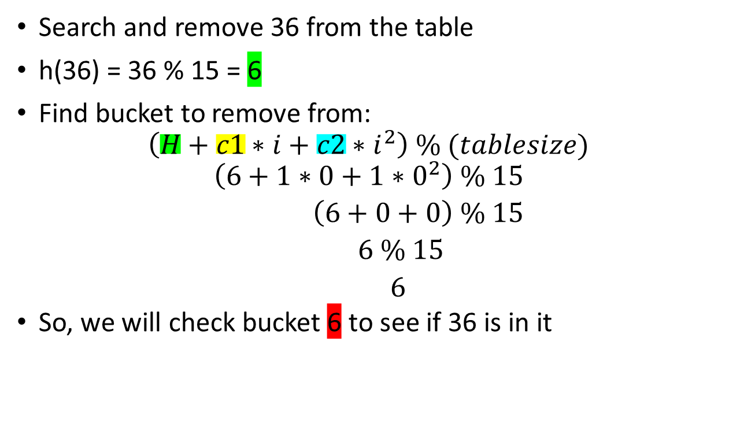
Assume that c1 = 1 and c2 =1 and that you are given the following hash table and the hash function is h(key) = key % 15
0
1 | 76
2
3 | 3
4
5 | 5
6 | 21
7
8 | 36
9 | 18
10 | 25
11
12 | 12
13
14 | 14
Search and remove 36 from the table
h(36) = 36 % 15 = 6
Find bucket to remove from:
$$\left(H+c1∗i+c2∗i^{2}\right) \% (tablesize)$$
$$\left(6+1∗0+1∗0^{2}\right) \% 15$$
$\left(6+0+0\right) \% 15$
$6 \% 15$
$6$
So, we will check bucket 6 to see if 36 is in it

Slide 23
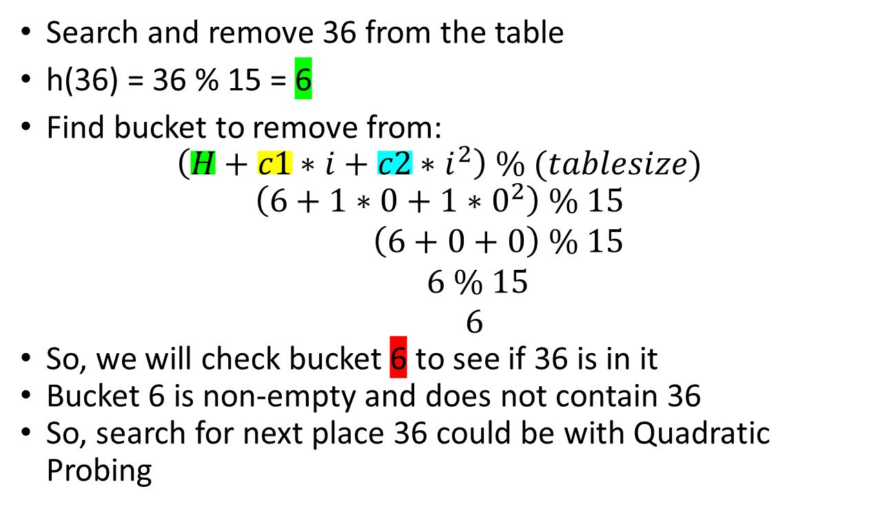
Assume that c1 = 1 and c2 =1 and that you are given the following hash table and the hash function is h(key) = key % 15
0
1 | 76
2
3 | 3
4
5 | 5
6 | 21
7
8 | 36
9 | 18
10 | 25
11
12 | 12
13
14 | 14
Search and remove 36 from the table
h(36) = 36 % 15 = 6
Find bucket to remove from:
$$\left(H+c1∗i+c2∗i^{2}\right) \% (tablesize)$$
$$\left(6+1∗0+1∗0^{2}\right) \% 15$$
$\left(6+0+0\right) \% 15$
$6 \% 15$
$6$
So, we will check bucket 6 to see if 36 is in it
Bucket 6 is non-empty and does not contain 36
So, search for next place 36 could be with Quadratic Probing

Slide 24
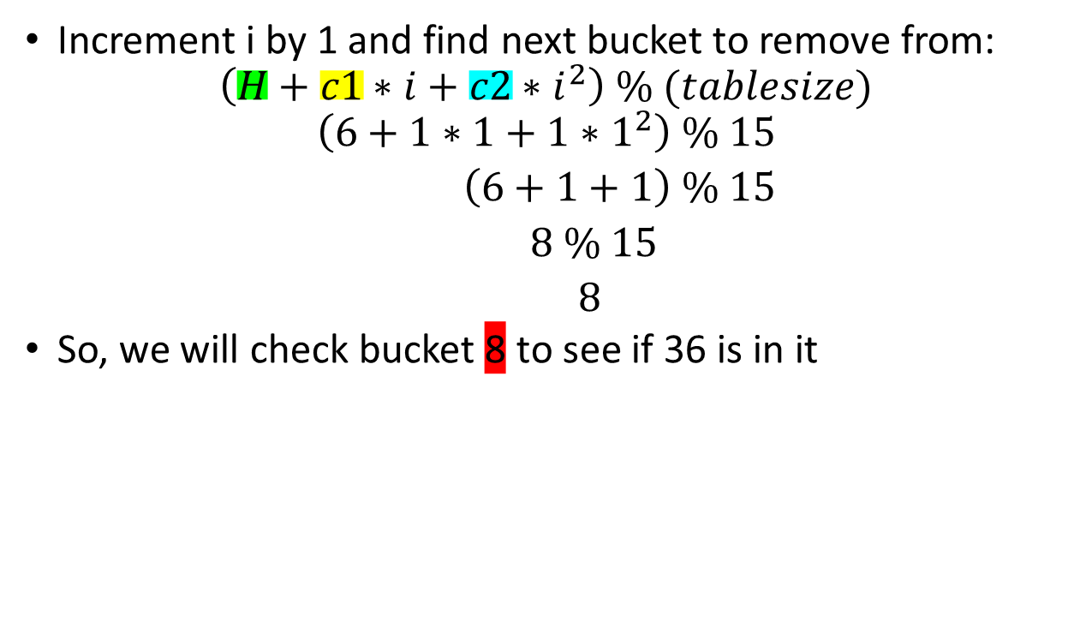
Assume that c1 = 1 and c2 =1 and that you are given the following hash table and the hash function is h(key) = key % 15
0
1 | 76
2
3 | 3
4
5 | 5
6 | 21
7
8 | 36
9 | 18
10 | 25
11
12 | 12
13
14 | 14
Increment i by 1 and find next bucket to remove from:
$$\left(H+c1∗i+c2∗i^{2}\right) \% (tablesize)$$
$$\left(6+1∗1+1∗1^{2}\right) \% 15$$
$\left(6+1+1\right) \% 15$
$8 \% 15$
$8$
So, we will check bucket 8 to see if 36 is in it

Slide 25
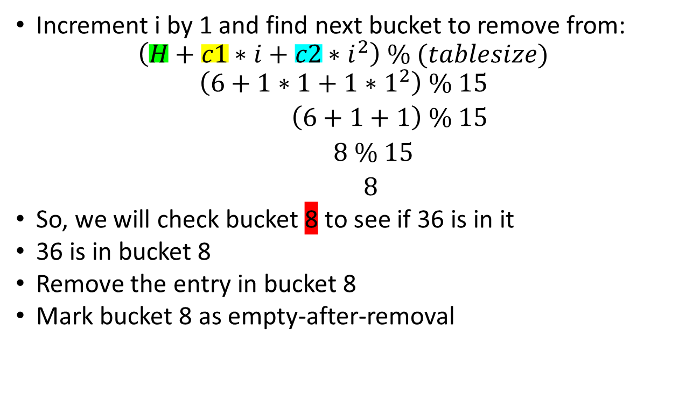
Assume that c1 = 1 and c2 =1 and that you are given the following hash table and the hash function is h(key) = key % 15
0
1 | 76
2
3 | 3
4
5 | 5
6 | 21
7
8
9 | 18
10 | 25
11
12 | 12
13
14 | 14
Increment i by 1 and find next bucket to remove from:
$$\left(H+c1∗i+c2∗i^{2}\right) \% (tablesize)$$
$$\left(6+1∗1+1∗1^{2}\right) \% 15$$
$\left(6+1+1\right) \% 15$
$8 \% 15$
$8$
So, we will check bucket 8 to see if 36 is in it
36 is in bucket 8
Remove the entry in bucket 8
Mark bucket 8 as empty-after-removal

Slide 26
Double Hashing

Slide 27
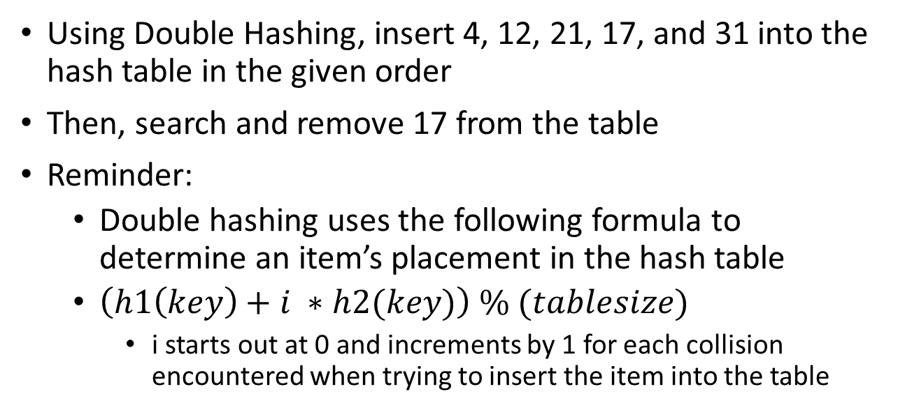
Assume h1(key) = key % 10 and h2(key) = key % 3
0
1
2
3
4
5 | 5
6
7 | 7
8
9
10 | 10
11
12
13
14
Using Double Hashing, insert 4, 12, 21, 17, and 31 into the hash table in the given order
Then, search and remove 17 from the table
Reminder:
Double hashing uses the following formula to determine an item’s placement in the hash table
$\left(h1\left(key\right)+i ∗h2(key)\right) \% (tablesize)$
i starts out at 0 and increments by 1 for each collision encountered when trying to insert the item into the table

Slide 28
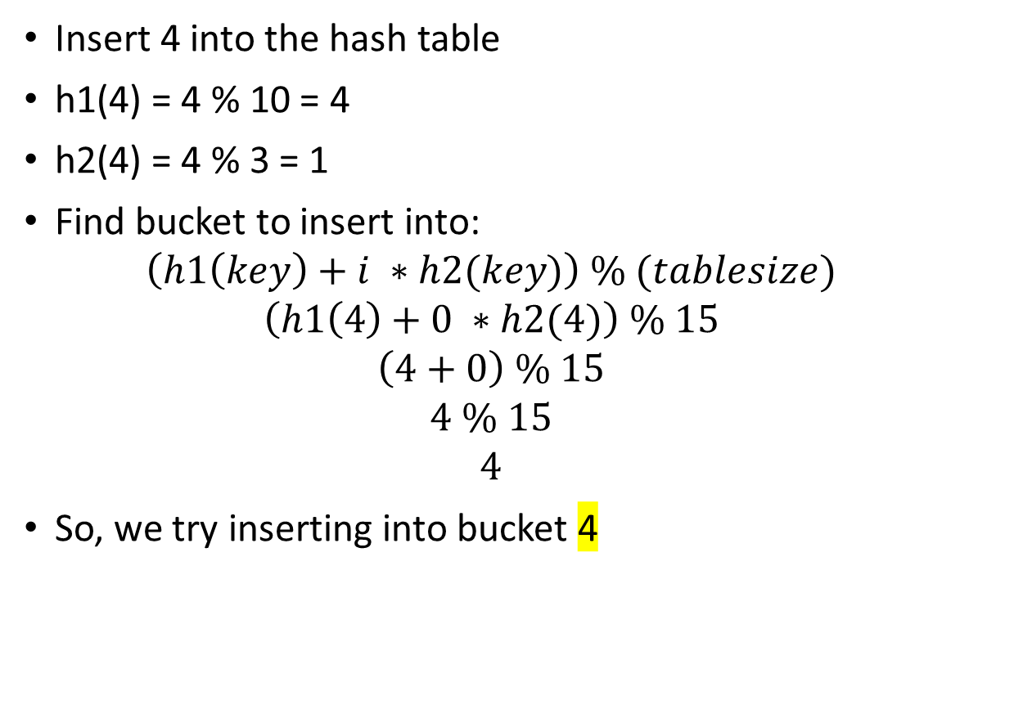
Assume h1(key) = key % 10 and h2(key) = key % 3
0
1
2
3
4
5 | 5
6
7 | 7
8
9
10 | 10
11
12
13
14
Insert 4 into the hash table
h1(4) = 4 % 10 = 4
h2(4) = 4 % 3 = 1
Find bucket to insert into:
$$\left(h1\left(key\right)+i ∗h2(key)\right) \% (tablesize)$$
$$\left(h1\left(4\right)+0 ∗h2(4)\right) \% 15$$
$$\left(4+0\right) \% 15$$
$$4 \% 15$$
$$4$$
So, we try inserting into bucket 4

Slide 29
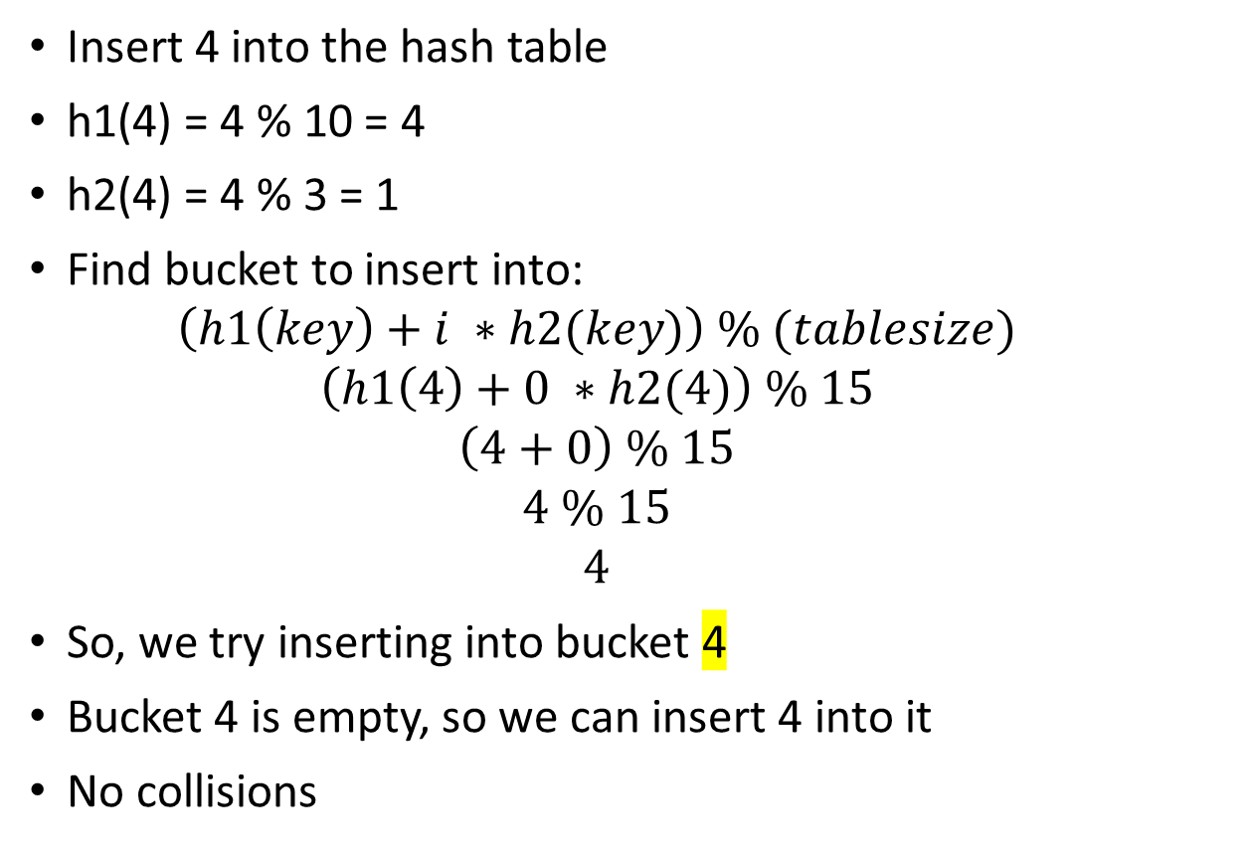
Assume h1(key) = key % 10 and h2(key) = key % 3
0
1
2
3
4 | 4
5 | 5
6
7 | 7
8
9
10 | 10
11
12
13
14
Insert 4 into the hash table
h1(4) = 4 % 10 = 4
h2(4) = 4 % 3 = 1
Find bucket to insert into:
$$\left(h1\left(key\right)+i ∗h2(key)\right) \% (tablesize)$$
$$\left(h1\left(4\right)+0 ∗h2(4)\right) \% 15$$
$$\left(4+0\right) \% 15$$
$$4 \% 15$$
$$4$$
So, we try inserting into bucket 4
Bucket 4 is empty, so we can insert 4 into it
No collisions

Slide 30

Assume h1(key) = key % 10 and h2(key) = key % 3
0
1
2
3
4 | 4
5 | 5
6
7 | 7
8
9
10 | 10
11
12
13
14
Insert 12 into the hash table
h1(12) = 12 % 10 = 2
h2(12) = 12 % 3 = 0
Find bucket to insert into:
$$\left(h1\left(key\right)+i ∗h2(key)\right) \% (tablesize)$$
$$\left(h1\left(12\right)+0 ∗h2(12)\right) \% 15$$
$$\left(2+0\right) \% 15$$
$$2 \% 15$$
$$2$$
So, we try inserting into bucket 2

Slide 31
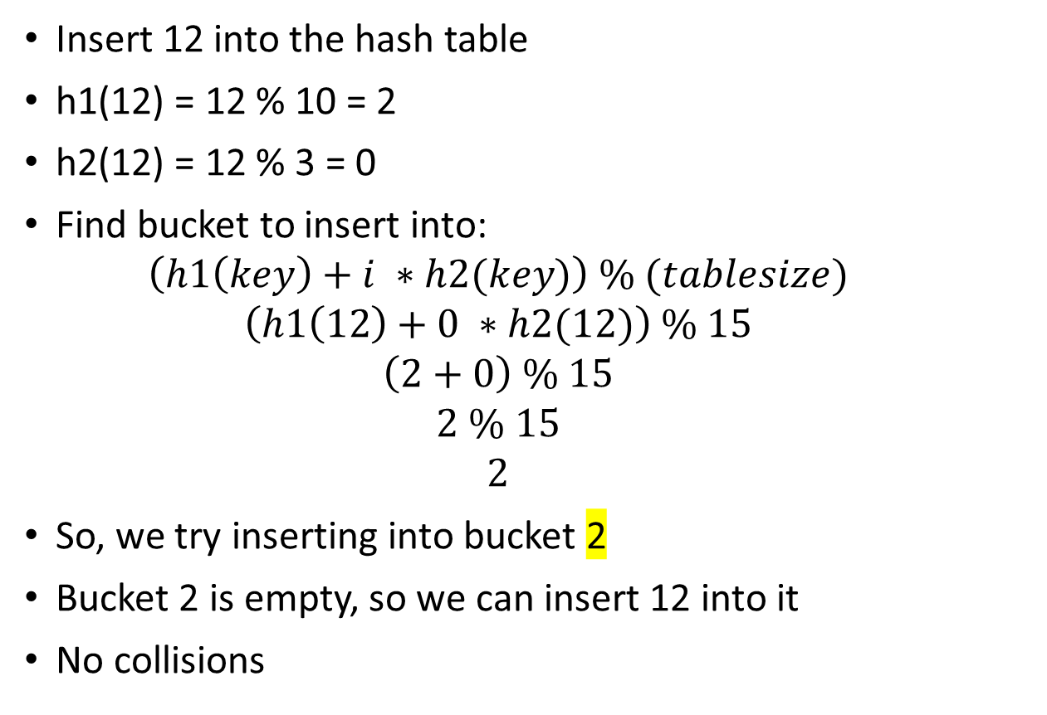
Assume h1(key) = key % 10 and h2(key) = key % 3
0
1
2 | 12
3
4 | 4
5 | 5
6
7 | 7
8
9
10 | 10
11
12
13
14
Insert 12 into the hash table
h1(12) = 12 % 10 = 2
h2(12) = 12 % 3 = 0
Find bucket to insert into:
$$\left(h1\left(key\right)+i ∗h2(key)\right) \% (tablesize)$$
$$\left(h1\left(12\right)+0 ∗h2(12)\right) \% 15$$
$$\left(2+0\right) \% 15$$
$$2 \% 15$$
$$2$$
So, we try inserting into bucket 2
Bucket 2 is empty, so we can insert 12 into it
No collisions

Slide 32

Assume h1(key) = key % 10 and h2(key) = key % 3
0
1
2 | 12
3
4 | 4
5 | 5
6
7 | 7
8
9
10 | 10
11
12
13
14
Insert 21 into the hash table
h1(21) = 21 % 10 = 1
h2(21) = 21 % 3 = 0
Find bucket to insert into:
$$\left(h1\left(key\right)+i ∗h2(key)\right) \% (tablesize)$$
$$\left(h1\left(21\right)+0 ∗h2(21)\right) \% 15$$
$$\left(1+0\right) \% 15$$
$$1 \% 15$$
$$1$$
So, we try inserting into bucket 1

Slide 33

Assume h1(key) = key % 10 and h2(key) = key % 3
0
1 | 21
2 | 12
3
4 | 4
5 | 5
6
7 | 7
8
9
10 | 10
11
12
13
14
Insert 21 into the hash table
h1(21) = 21 % 10 = 1
h2(21) = 21 % 3 = 0
Find bucket to insert into:
$$\left(h1\left(key\right)+i ∗h2(key)\right) \% (tablesize)$$
$$\left(h1\left(21\right)+0 ∗h2(21)\right) \% 15$$
$$\left(1+0\right) \% 15$$
$$1 \% 15$$
$$1$$
So, we try inserting into bucket 1
Bucket 1 is empty, so we can insert 21 into it
No collisions

Slide 34
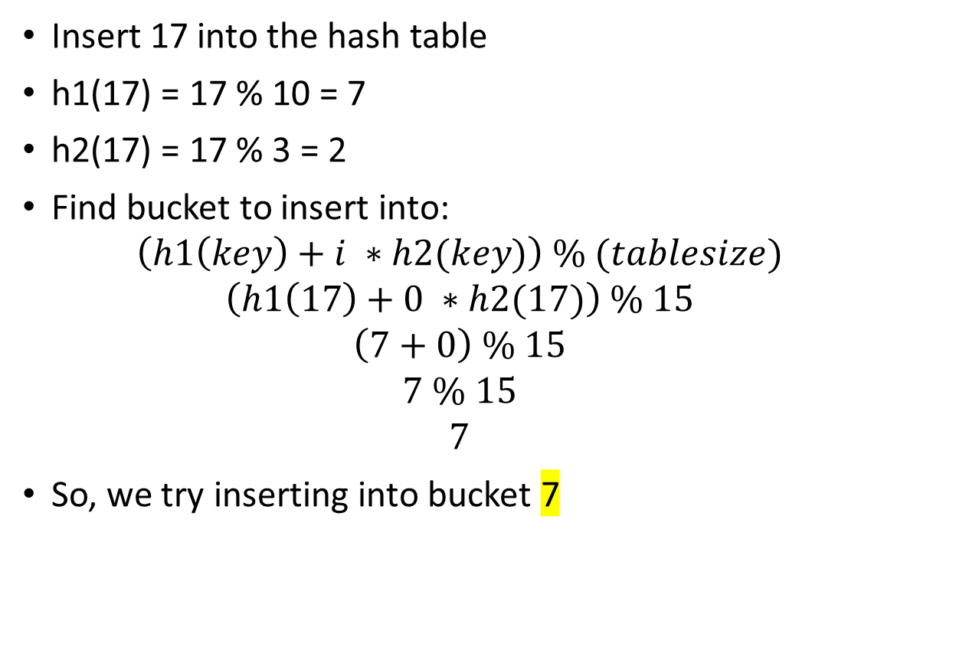
Assume h1(key) = key % 10 and h2(key) = key % 3
0
1 | 21
2 | 12
3
4 | 4
5 | 5
6
7 | 7
8
9
10 | 10
11
12
13
14
Insert 17 into the hash table
h1(17) = 17 % 10 = 7
h2(17) = 17 % 3 = 2
Find bucket to insert into:
$$\left(h1\left(key\right)+i ∗h2(key)\right) \% (tablesize)$$
$$\left(h1\left(17\right)+0 ∗h2(17)\right) \% 15$$
$$\left(7+0\right) \% 15$$
$$7 \% 15$$
$$7$$
So, we try inserting into bucket 7

Slide 35
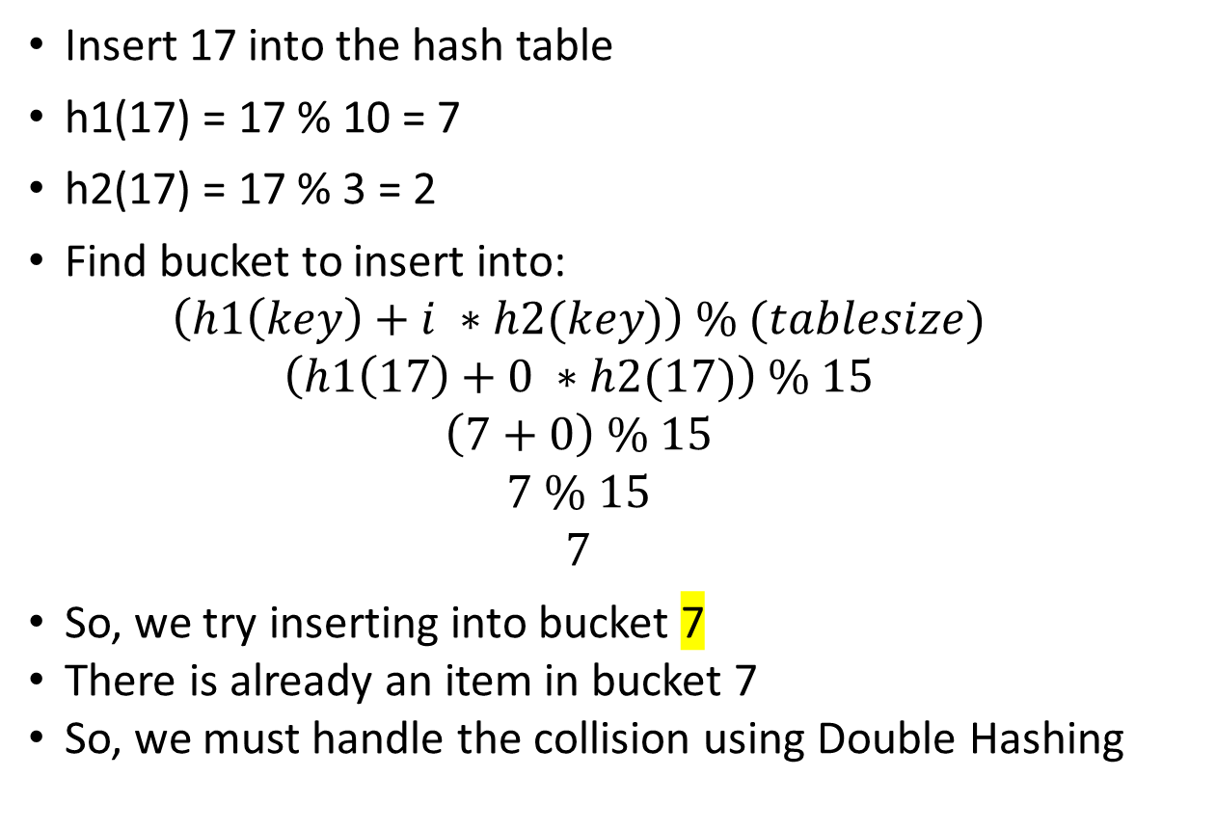
Assume h1(key) = key % 10 and h2(key) = key % 3
0
1 | 21
2 | 12
3
4 | 4
5 | 5
6
7 | 7
8
9
10 | 10
11
12
13
14
Insert 17 into the hash table
h1(17) = 17 % 10 = 7
h2(17) = 17 % 3 = 2
Find bucket to insert into:
$$\left(h1\left(key\right)+i ∗h2(key)\right) \% (tablesize)$$
$$\left(h1\left(17\right)+0 ∗h2(17)\right) \% 15$$
$$\left(7+0\right) \% 15$$
$$7 \% 15$$
$$7$$
So, we try inserting into bucket 7
There is already an item in bucket 7
So, we must handle the collision using Double Hashing

Slide 36
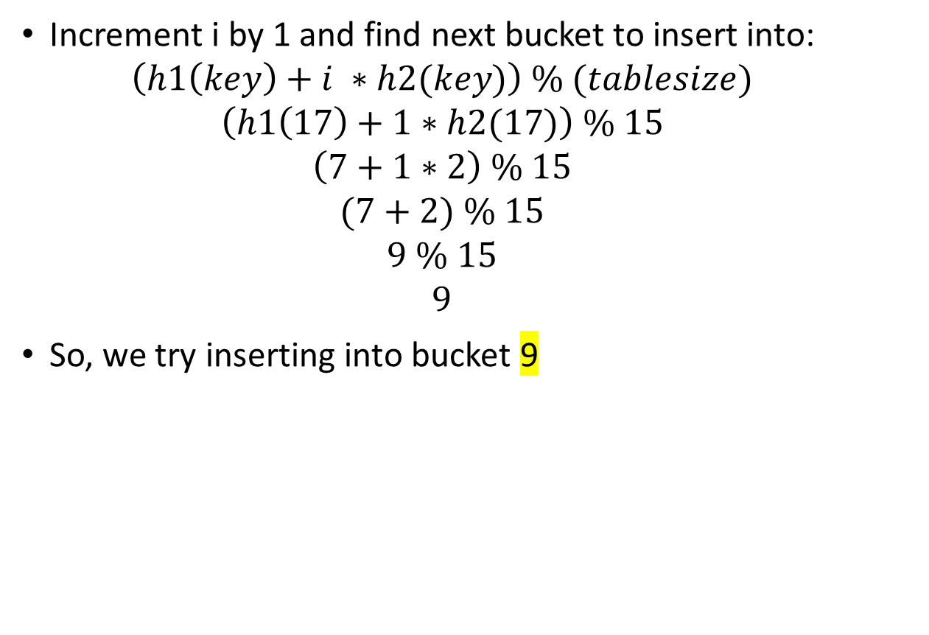
Assume h1(key) = key % 10 and h2(key) = key % 3
0
1 | 21
2 | 12
3
4 | 4
5 | 5
6
7 | 7
8
9
10 | 10
11
12
13
14
Increment i by 1 and find next bucket to insert into:
$$\left(h1\left(key\right)+i ∗h2(key)\right) \% (tablesize)$$
$$\left(h1\left(17\right)+1∗h2(17)\right) \% 15$$
$$\left(7+1∗2\right) \% 15$$
$$(7+2) \% 15$$
$$9 \% 15$$
$$9$$
So, we try inserting into bucket 9

Slide 37
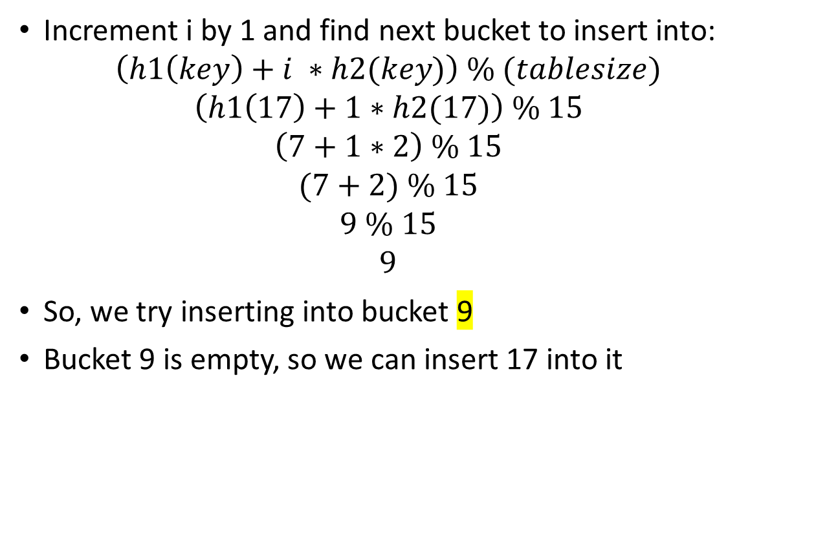
Assume h1(key) = key % 10 and h2(key) = key % 3
0
1 | 21
2 | 12
3
4 | 4
5 | 5
6
7 | 7
8
9 | 17
10 | 10
11
12
13
14
Increment i by 1 and find next bucket to insert into:
$$\left(h1\left(key\right)+i ∗h2(key)\right) \% (tablesize)$$
$$\left(h1\left(17\right)+1∗h2(17)\right) \% 15$$
$$\left(7+1∗2\right) \% 15$$
$$(7+2) \% 15$$
$$9 \% 15$$
$$9$$
So, we try inserting into bucket 9
Bucket 9 is empty, so we can insert 17 into it

Slide 38

Assume h1(key) = key % 10 and h2(key) = key % 3
0
1 | 21
2 | 12
3
4 | 4
5 | 5
6
7 | 7
8
9 | 17
10 | 10
11
12
13
14
Insert 31 into the hash table
h1(31) = 31 % 10 = 1
h2(31) = 31 % 3 = 1
Find bucket to insert into:
$$\left(h1\left(key\right)+i ∗h2(key)\right) \% (tablesize)$$
$$\left(h1\left(31\right)+0 ∗h2(31)\right) \% 15$$
$$\left(1+0\right) \% 15$$
$$1 \% 15$$
$$1$$
So, we try inserting into bucket 1

Slide 39
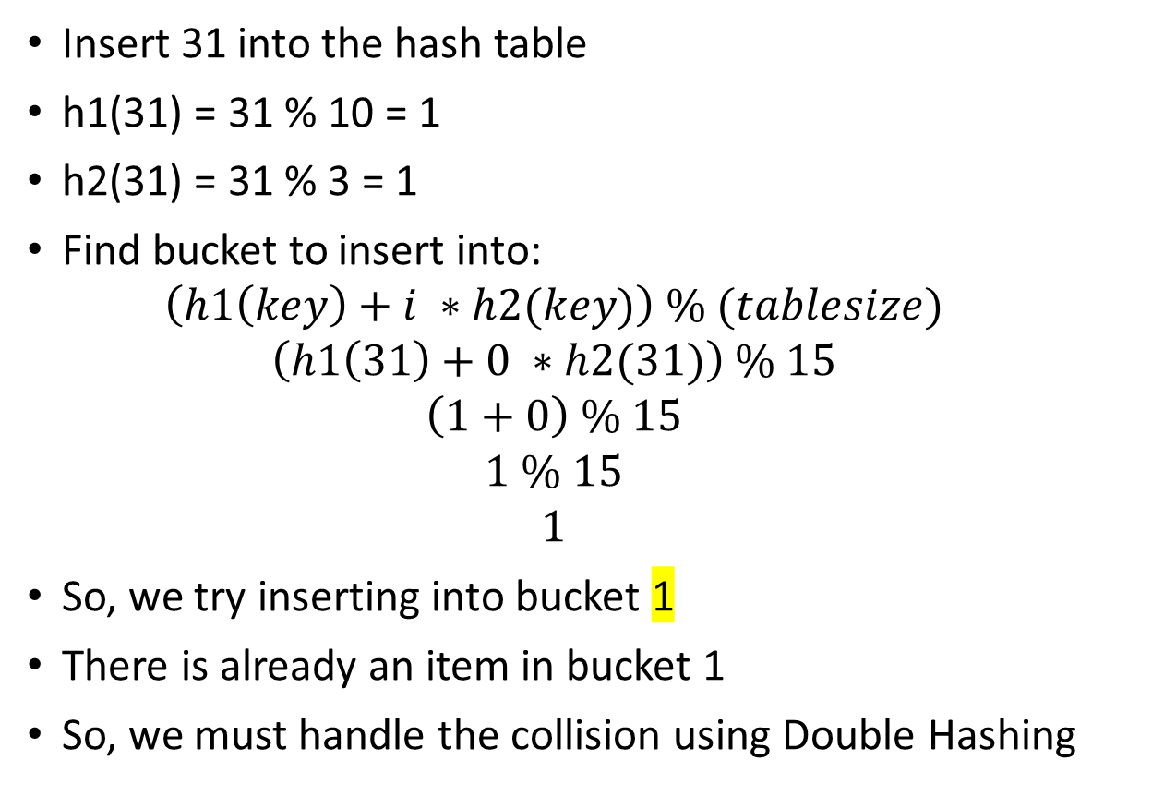
Assume h1(key) = key % 10 and h2(key) = key % 3
0
1 | 21
2 | 12
3
4 | 4
5 | 5
6
7 | 7
8
9 | 17
10 | 10
11
12
13
14
Insert 31 into the hash table
h1(31) = 31 % 10 = 1
h2(31) = 31 % 3 = 1
Find bucket to insert into:
$$\left(h1\left(key\right)+i ∗h2(key)\right) \% (tablesize)$$
$$\left(h1\left(31\right)+0 ∗h2(31)\right) \% 15$$
$$\left(1+0\right) \% 15$$
$$1 \% 15$$
$$1$$
So, we try inserting into bucket 1
There is already an item in bucket 1
So, we must handle the collision using Double Hashing

Slide 40
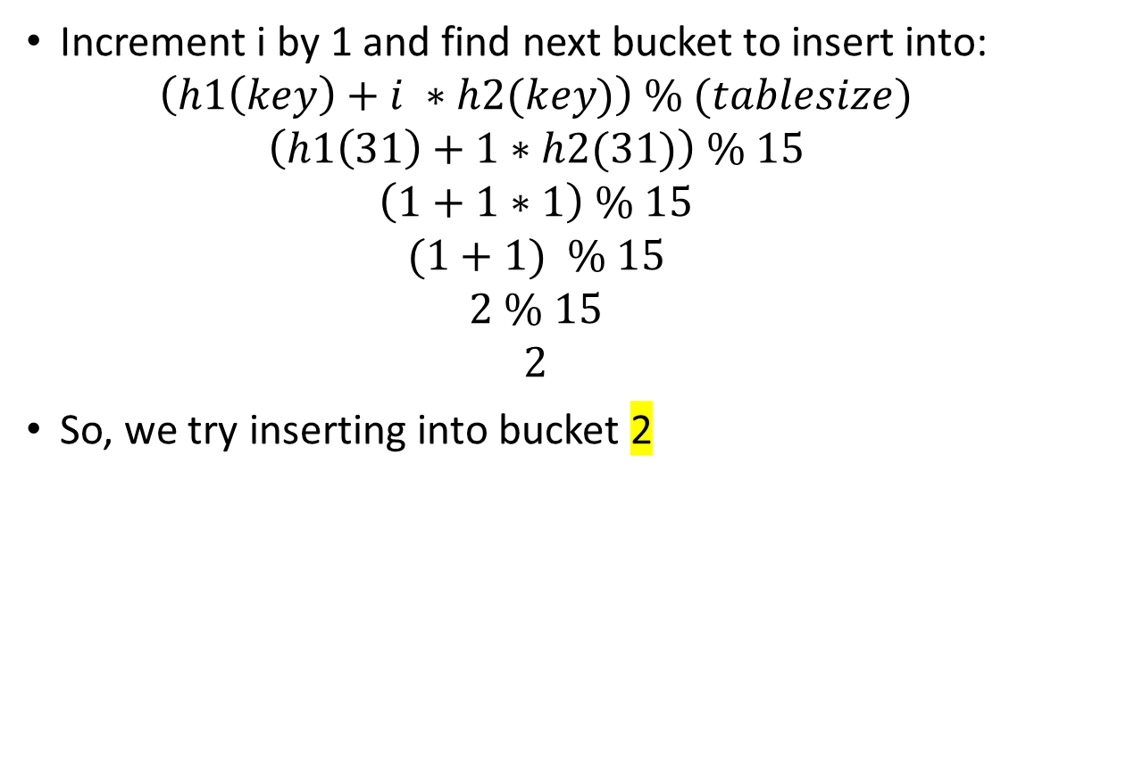
Assume h1(key) = key % 10 and h2(key) = key % 3
0
1 | 21
2 | 12
3
4 | 4
5 | 5
6
7 | 7
8
9 | 17
10 | 10
11
12
13
14
Increment i by 1 and find next bucket to insert into:
$$\left(h1\left(key\right)+i ∗h2(key)\right) \% (tablesize)$$
$$\left(h1\left(31\right)+1∗h2(31)\right) \% 15$$
$$\left(1+1∗1\right) \% 15$$
$$(1+1) \% 15$$
$$2 \% 15$$
$$2$$
So, we try inserting into bucket 2

Slide 41
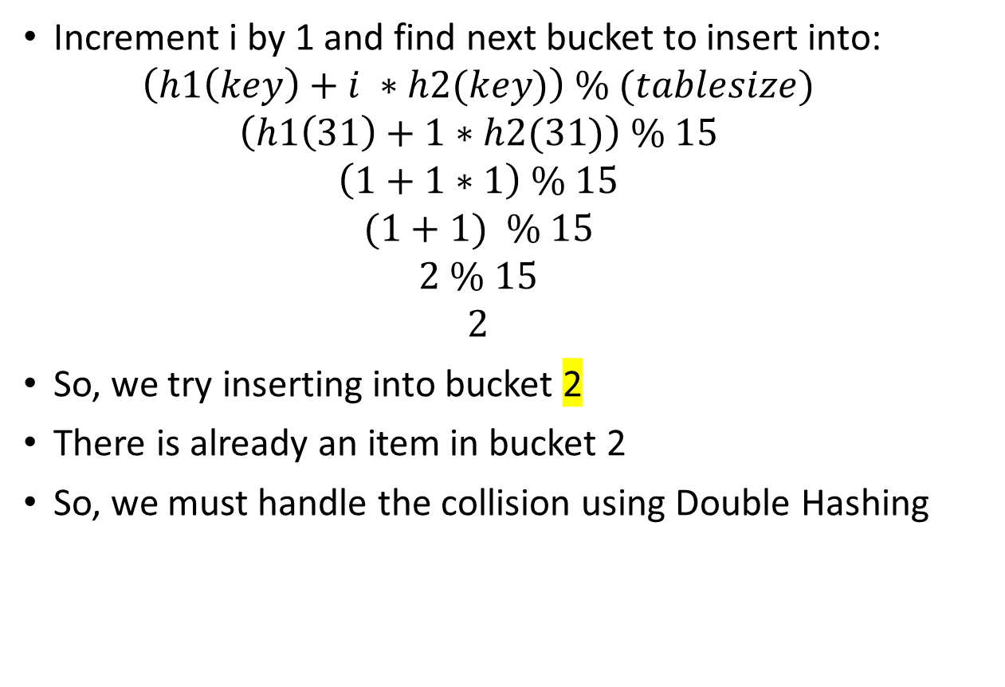
Assume h1(key) = key % 10 and h2(key) = key % 3
0
1 | 21
2 | 12
3
4 | 4
5 | 5
6
7 | 7
8
9 | 17
10 | 10
11
12
13
14
Increment i by 1 and find next bucket to insert into:
$$\left(h1\left(key\right)+i ∗h2(key)\right) \% (tablesize)$$
$$\left(h1\left(31\right)+1∗h2(31)\right) \% 15$$
$$\left(1+1∗1\right) \% 15$$
$$(1+1) \% 15$$
$$2 \% 15$$
$$2$$
So, we try inserting into bucket 2
There is already an item in bucket 2
So, we must handle the collision using Double Hashing

Slide 42

Assume h1(key) = key % 10 and h2(key) = key % 3
0
1 | 21
2 | 12
3
4 | 4
5 | 5
6
7 | 7
8
9 | 17
10 | 10
11
12
13
14
Increment i by 1 and find next bucket to insert into:
$$\left(h1\left(key\right)+i ∗h2(key)\right) \% (tablesize)$$
$$\left(h1\left(31\right)+2∗h2(31)\right) \% 15$$
$$\left(1+2∗1\right) \% 15$$
$$(1+2) \% 15$$
$$3 \% 15$$
$$3$$
So, we try inserting into bucket 3

Slide 43

Assume h1(key) = key % 10 and h2(key) = key % 3
0
1 | 21
2 | 12
3 | 31
4 | 4
5 | 5
6
7 | 7
8
9 | 17
10 | 10
11
12
13
14
Increment i by 1 and find next bucket to insert into:
$$\left(h1\left(key\right)+i ∗h2(key)\right) \% (tablesize)$$
$$\left(h1\left(31\right)+2∗h2(31)\right) \% 15$$
$$\left(1+2∗1\right) \% 15$$
$$(1+2) \% 15$$
$$3 \% 15$$
$$3$$
So, we try inserting into bucket 3
Bucket 3 is empty so we can insert 31 into it

Slide 44
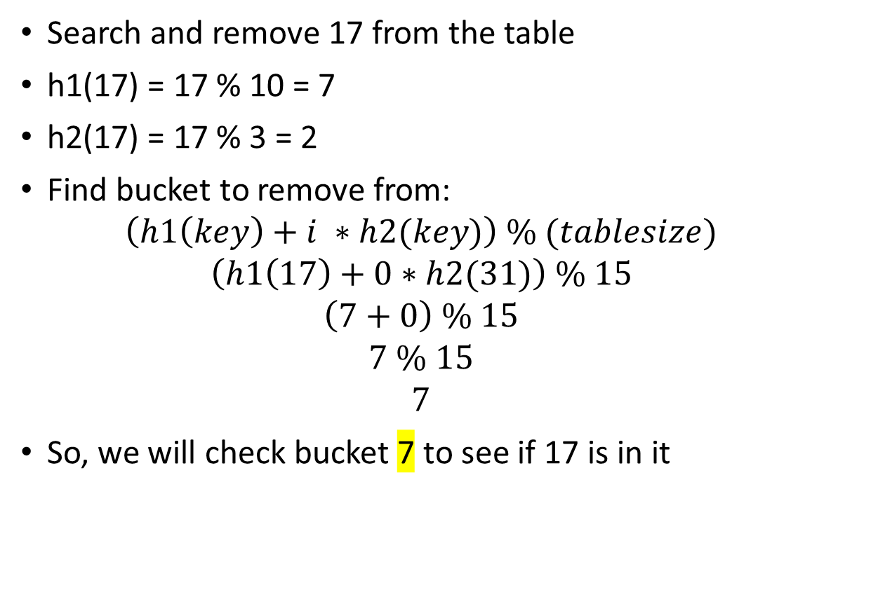
Assume h1(key) = key % 10 and h2(key) = key % 3
0
1 | 21
2 | 12
3 | 31
4 | 4
5 | 5
6
7 | 7
8
9 | 17
10 | 10
11
12
13
14
Search and remove 17 from the table
h1(17) = 17 % 10 = 7
h2(17) = 17 % 3 = 2
Find bucket to remove from:
$$\left(h1\left(key\right)+i ∗h2(key)\right) \% (tablesize)$$
$$\left(h1\left(17\right)+0∗h2(31)\right) \% 15$$
$$\left(7+0\right) \% 15$$
$$7 \% 15$$
$$7$$
So, we will check bucket 7 to see if 17 is in it

Slide 45
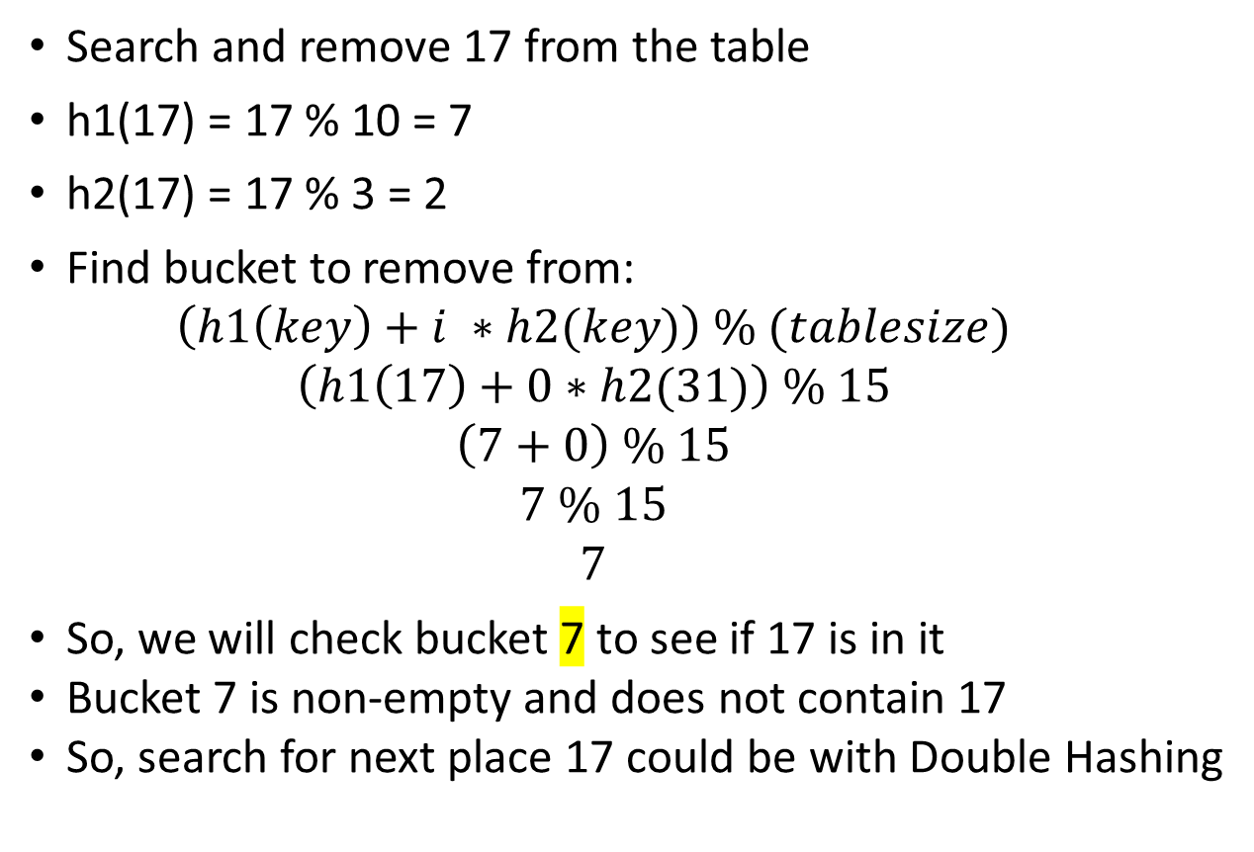
Assume h1(key) = key % 10 and h2(key) = key % 3
0
1 | 21
2 | 12
3 | 31
4 | 4
5 | 5
6
7 | 7
8
9 | 17
10 | 10
11
12
13
14
Search and remove 17 from the table
h1(17) = 17 % 10 = 7
h2(17) = 17 % 3 = 2
Find bucket to remove from:
$$\left(h1\left(key\right)+i ∗h2(key)\right) \% (tablesize)$$
$$\left(h1\left(17\right)+0∗h2(31)\right) \% 15$$
$$\left(7+0\right) \% 15$$
$$7 \% 15$$
$$7$$
So, we will check bucket 7 to see if 17 is in it
Bucket 7 is non-empty and does not contain 17
So, search for next place 17 could be with Double Hashing

Slide 46
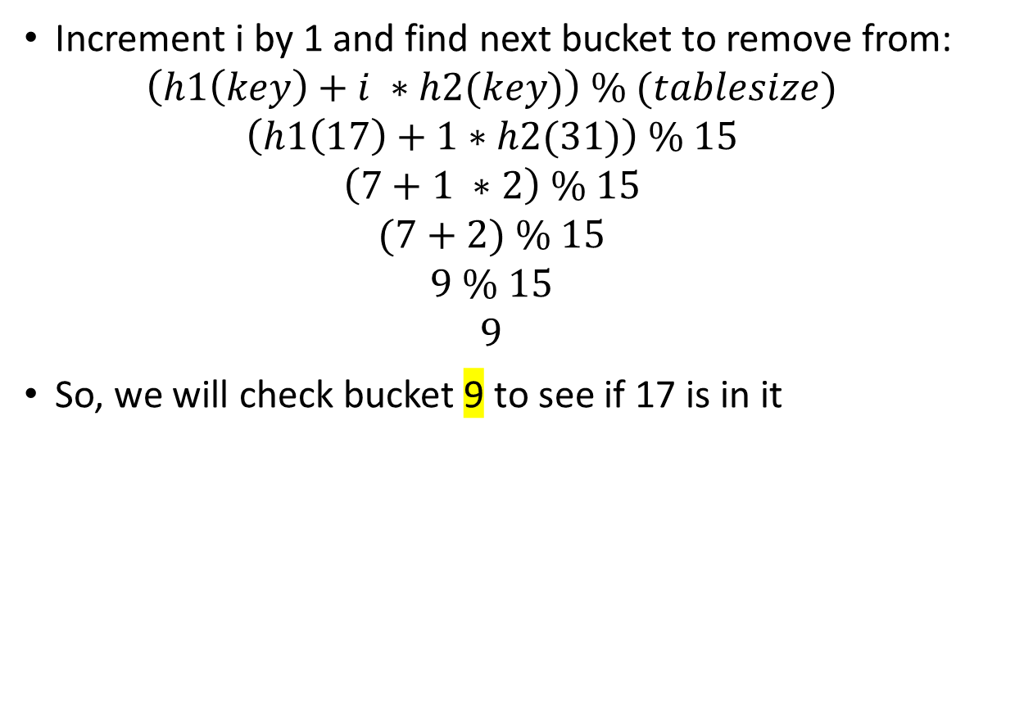
Assume h1(key) = key % 10 and h2(key) = key % 3
0
1 | 21
2 | 12
3 | 31
4 | 4
5 | 5
6
7 | 7
8
9 | 17
10 | 10
11
12
13
14
Increment i by 1 and find next bucket to remove from:
$$\left(h1\left(key\right)+i ∗h2(key)\right) \% (tablesize)$$
$$\left(h1\left(17\right)+1∗h2(31)\right) \% 15$$
$$\left(7+1 ∗2\right) \% 15$$
$$(7+2) \% 15$$
$$9 \% 15$$
$$9$$
So, we will check bucket 9 to see if 17 is in it

Slide 47
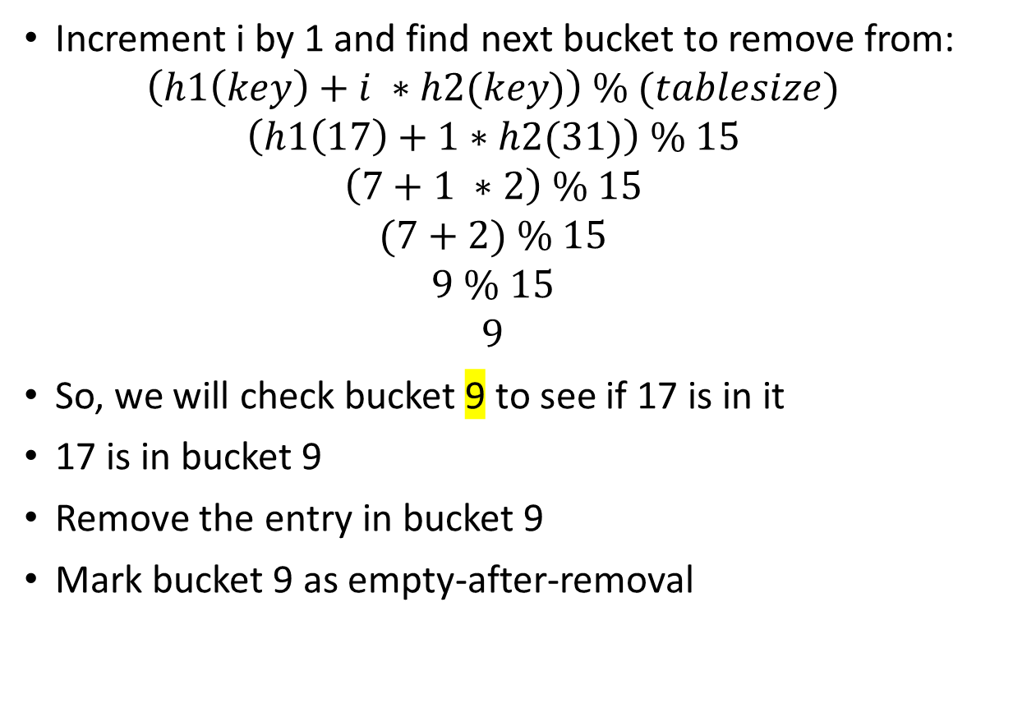
Assume h1(key) = key % 10 and h2(key) = key % 3
0
1 | 21
2 | 12
3 | 31
4 | 4
5 | 5
6
7 | 7
8
9 | 17
10 | 10
11
12
13
14
Increment i by 1 and find next bucket to remove from:
$$\left(h1\left(key\right)+i ∗h2(key)\right) \% (tablesize)$$
$$\left(h1\left(17\right)+1∗h2(31)\right) \% 15$$
$$\left(7+1 ∗2\right) \% 15$$
$$(7+2) \% 15$$
$$9 \% 15$$
$$9$$
So, we will check bucket 9 to see if 17 is in it
17 is in bucket 9
Remove the entry in bucket 9
Mark bucket 9 as empty-after-removal

Slide 48
Linear Probing

Slide 49
Assume h(key) = key % 15
0
1
2
3
4
5 | 5
6
7 | 7
8
9
10 | 10
11
12
13
14
Using Linear Probing, insert 6, 25, and 17 into the hash table in the given order
Then, search and remove 10 from the table
Then insert 12 and 34 into the hash table in the given order
Then search and remove 25 from the table
Reminder:
If a collision occurs and Linear Probing is used as the collision resolution method, subsequent buckets will be checked until an empty bucket is found for the insert to occur
The search starts from the bucket the collision occurred in

Slide 50
Assume h(key) = key % 15
0
1
2
3
4
5 | 5
6
7 | 7
8
9
10 | 10
11
12
13
14
Insert 6 into the hash table
h(6) = 6 % 15 = 6
So, we will try inserting into bucket 6

Slide 51
Assume h(key) = key % 15
0
1
2
3
4
5 | 5
6 | 6
7 | 7
8
9
10 | 10
11
12
13
14
Insert 6 into the hash table
h(6) = 6 % 15 = 6
So, we will try inserting into bucket 6
Bucket 6 is empty, so we can insert 6 into it

Slide 52
Assume h(key) = key % 15
0
1
2
3
4
5 | 5
6 | 6
7 | 7
8
9
10 | 10
11
12
13
14
Insert 25 into the hash table
h(25) = 25 % 15 = 10
So, we will try inserting into bucket 10

Slide 53
Assume h(key) = key % 15
0
1
2
3
4
5 | 5
6 | 6
7 | 7
8
9
10 | 10
11
12
13
14
Insert 25 into the hash table
h(25) = 25 % 15 = 10
So, we will try inserting into bucket 10
There is already an item in bucket 10
To resolve this collision, check for the next empty bucket

Slide 54
Assume h(key) = key % 15
0
1
2
3
4
5 | 5
6 | 6
7 | 7
8
9
10 | 10
11
12
13
14
Insert 25 into the hash table
h(25) = 25 % 15 = 10
So, we will try inserting into bucket 10
There is already an item in bucket 10
To resolve this collision, check for the next empty bucket
In this case, it is 11

Slide 55
Assume h(key) = key % 15
0
1
2
3
4
5 | 5
6 | 6
7 | 7
8
9
10 | 10
11 | 25
12
13
14
Insert 25 into the hash table
h(25) = 25 % 15 = 10
So, we will try inserting into bucket 10
There is already an item in bucket 10
To resolve this collision, check for the next empty bucket
In this case, it is 11
So, we can insert 25 into bucket 11

Slide 56
Assume h(key) = key % 15
0
1
2
3
4
5 | 5
6 | 6
7 | 7
8
9
10 | 10
11 | 25
12
13
14
Insert 17 into the hash table
h(17) = 17 % 15 = 2
So, we will try inserting into bucket 2

Slide 57
Assume h(key) = key % 15
0
1
2 | 17
3
4
5 | 5
6 | 6
7 | 7
8
9
10 | 10
11 | 25
12
13
14
Insert 17 into the hash table
h(17) = 17 % 15 = 2
So, we will try inserting into bucket 2
Bucket 2 is empty, so we can insert 17 into it

Slide 58
Assume h(key) = key % 15
0
1
2 | 17
3
4
5 | 5
6 | 6
7 | 7
8
9
10 | 10
11 | 25
12
13
14
Search and remove 10 from the hash table
h(10) = 10 % 15 = 10
So, we will check bucket 10 and see if 10 is in it

Slide 59
Assume h(key) = key % 15
0
1
2 | 17
3
4
5 | 5
6 | 6
7 | 7
8
9
10
11 | 25
12
13
14
Search and remove 10 from the hash table
h(10) = 10 % 15 = 10
So, we will check bucket 10 and see if 10 is in it
10 is in bucket 10, so we can remove the entry
Mark bucket 10 as empty-after-removal

Slide 60
Assume h(key) = key % 15
0
1
2 | 17
3
4
5 | 5
6 | 6
7 | 7
8
9
10
11 | 25
12
13
14
Insert 12 into the hash table
h(12) = 12 % 15 = 12
So, we will try inserting into bucket 12

Slide 61
Assume h(key) = key % 15
0
1
2 | 17
3
4
5 | 5
6 | 6
7 | 7
8
9
10
11 | 25
12 | 12
13
14
Insert 12 into the hash table
h(12) = 12 % 15 = 12
So, we will try inserting into bucket 12
Bucket 12 is empty, so we can insert 12 into it

Slide 62
Assume h(key) = key % 15
0
1
2 | 17
3
4
5 | 5
6 | 6
7 | 7
8
9
10
11 | 25
12 | 12
13
14
Insert 34 into the hash table
h(34) = 34 % 15 = 4
So, we will try inserting into bucket 4

Slide 63
Assume h(key) = key % 15
0
1
2 | 17
3
4 | 34
5 | 5
6 | 6
7 | 7
8
9
10
11 | 25
12 | 12
13
14
Insert 34 into the hash table
h(34) = 34 % 15 = 4
So, we will try inserting into bucket 4
Bucket 4 is empty, so we can insert 34 into it

Slide 64
Assume h(key) = key % 15
0
1
2 | 17
3
4 | 34
5 | 5
6 | 6
7 | 7
8
9
10
11 | 25
12 | 12
13
14
Search and remove 25 from the table
h(25) = 25 % 15 = 10
So, we will check Bucket 10 and see if 25 is in it

Slide 65
Assume h(key) = key % 15
0
1
2 | 17
3
4 | 34
5 | 5
6 | 6
7 | 7
8
9
10
11 | 25
12 | 12
13
14
Search and remove 25 from the table
h(25) = 25 % 15 = 10
So, we will check Bucket 10 and see if 25 is in it
Bucket 10 is empty but was marked empty-after-removal (from earlier)

Slide 66
Assume h(key) = key % 15
0
1
2 | 17
3
4 | 34
5 | 5
6 | 6
7 | 7
8
9
10
11 | 25
12 | 12
13
14
Search and remove 25 from the table
h(25) = 25 % 15 = 10
So, we will check Bucket 10 and see if 25 is in it
Bucket 10 is empty but was marked empty-after-removal (from earlier)
So, we check the next bucket (11) for 25

Slide 67
Assume h(key) = key % 15
0
1
2 | 17
3
4 | 34
5 | 5
6 | 6
7 | 7
8
9
10
11
12 | 12
13
14
Search and remove 25 from the table
h(25) = 25 % 15 = 10
So, we will check Bucket 10 and see if 25 is in it
Bucket 10 is empty but was marked empty-after-removal (from earlier)
So, we check the next bucket (11) for 25
25 is in bucket 11, so we can remove the entry from the bucket
Mark bucket 11 as empty-after-removal

